Slide 1
Lab 2 (Distributed System)
Rajib Chandra Das Sarker Miraz Mahfuz

Slide 2
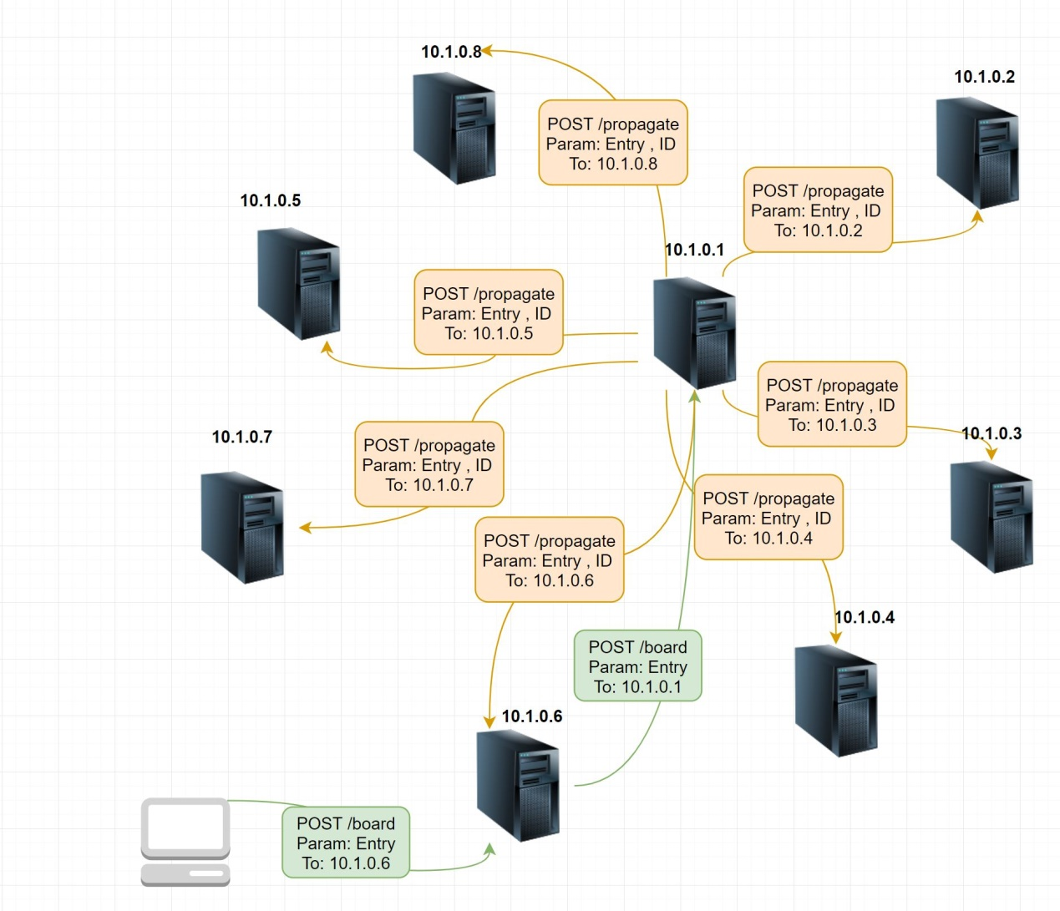

Slide 3
Advantages
Data is Consistent.
Handle requests Concurrently.
Using Threadpool rather than spawning threads for concurrent requests.
Imposing delay rather than crashing for massive requests.

Slide 4
What’s new in Lab 2!!

Slide 5
Assumptions for Bully
the system is synchronous.
processes may fail at any time, including during execution of the algorithm.
a process fails by stopping and returns from failure by restarting.
there is a failure detector which detects failed processes.
message delivery between processes is reliable.
each process knows its own process id and address, and that of every other process.

Slide 6
Our experiment
Tried to implement it in asynchronous manner
Implement Heartbeat for all servers (naive)
We reduce messages for the algorithm
We implement different state to manage election faster.

Slide 7
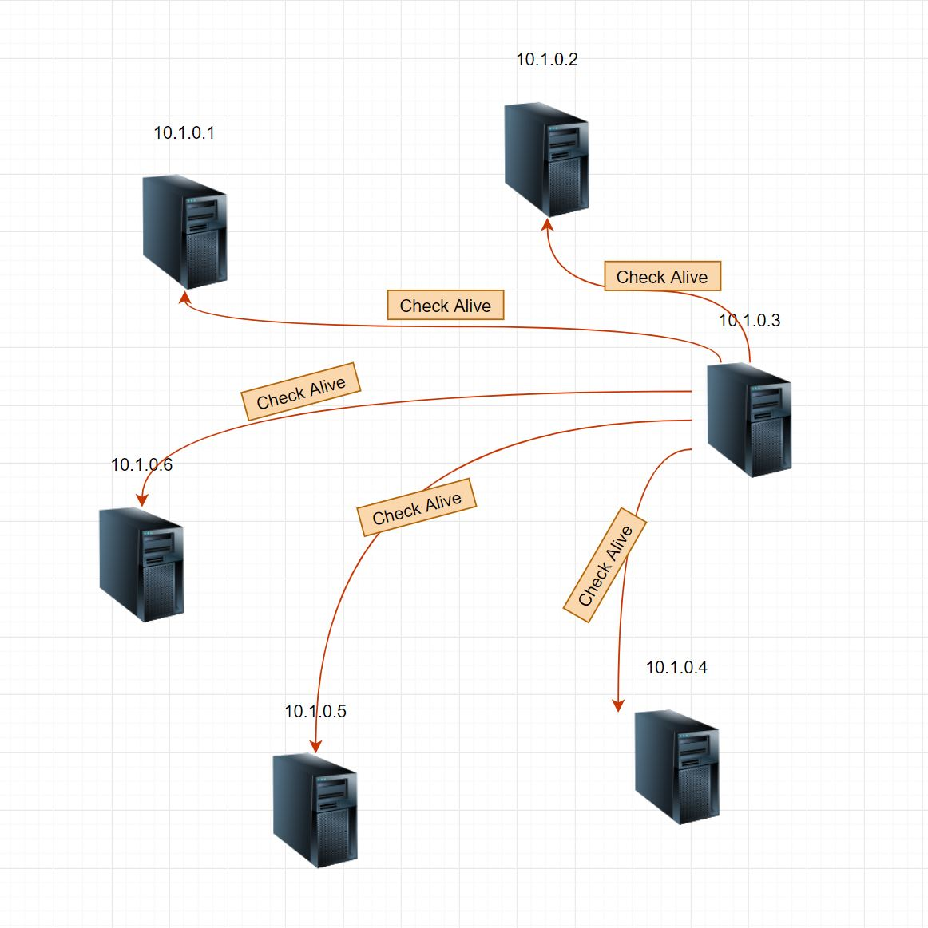

Slide 8
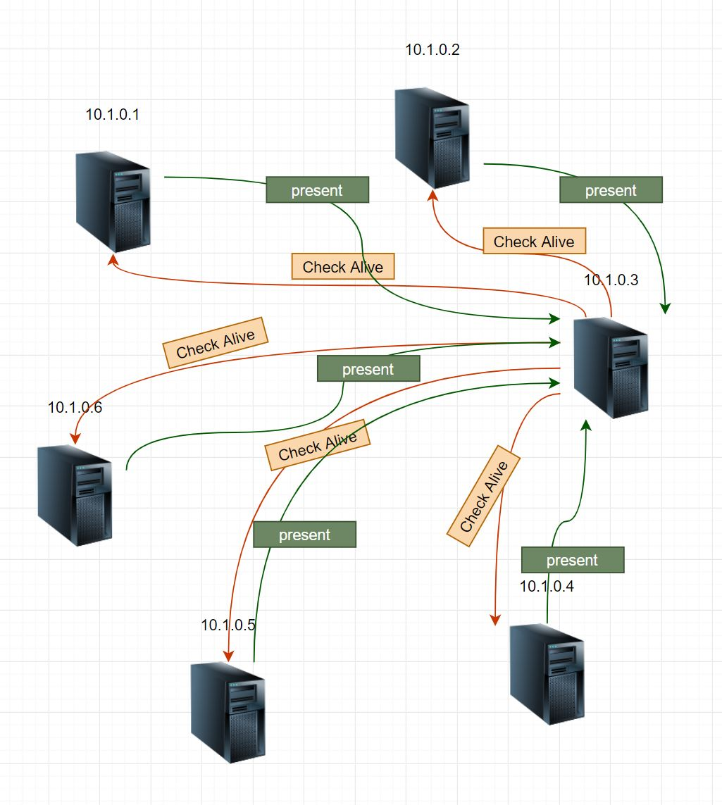

Slide 9

Let’s do the Election!!

Slide 10
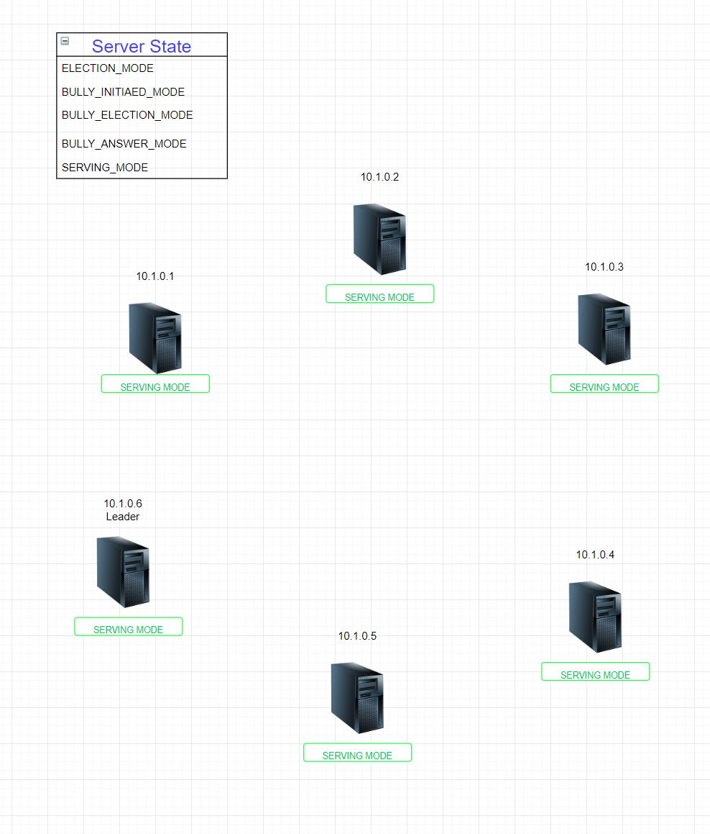
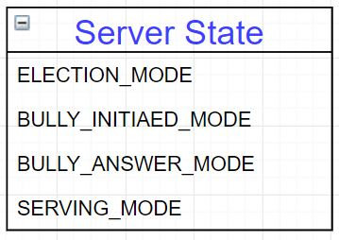

Slide 11
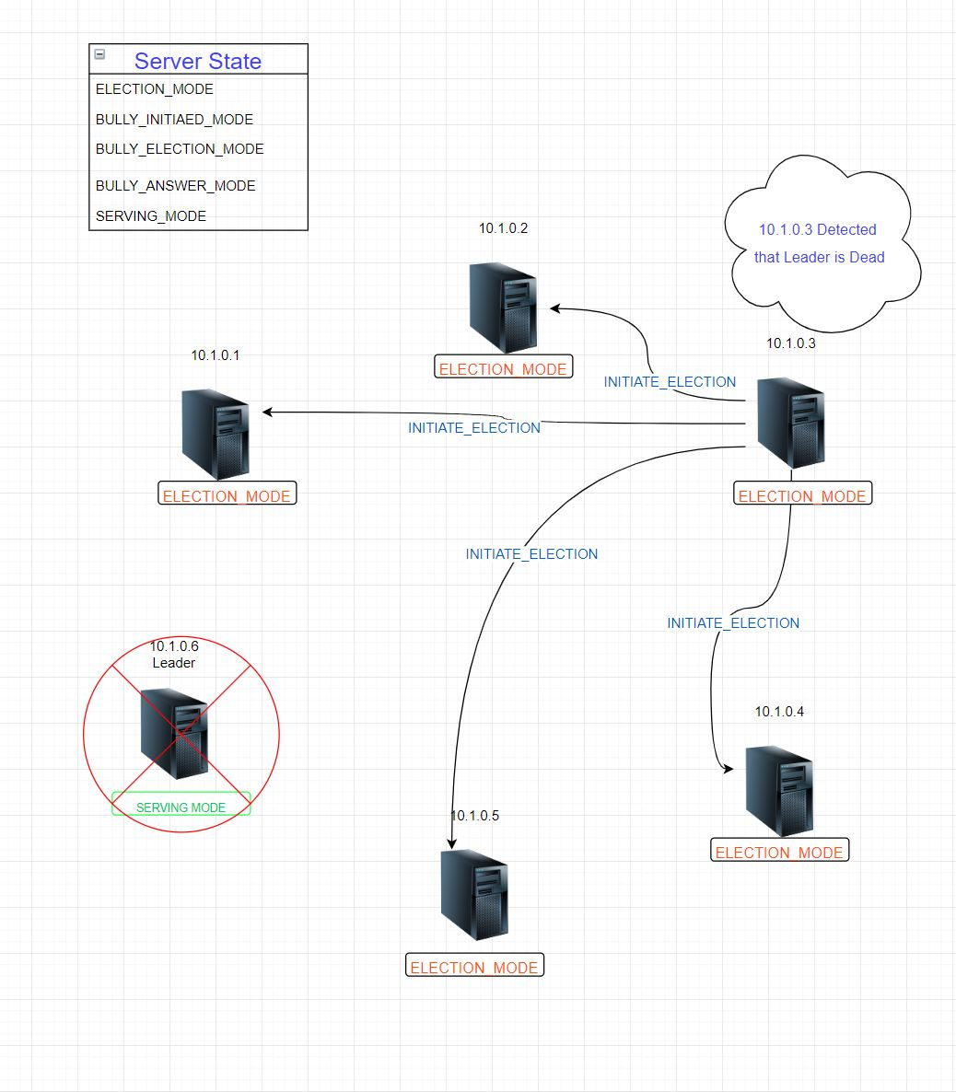

Slide 12
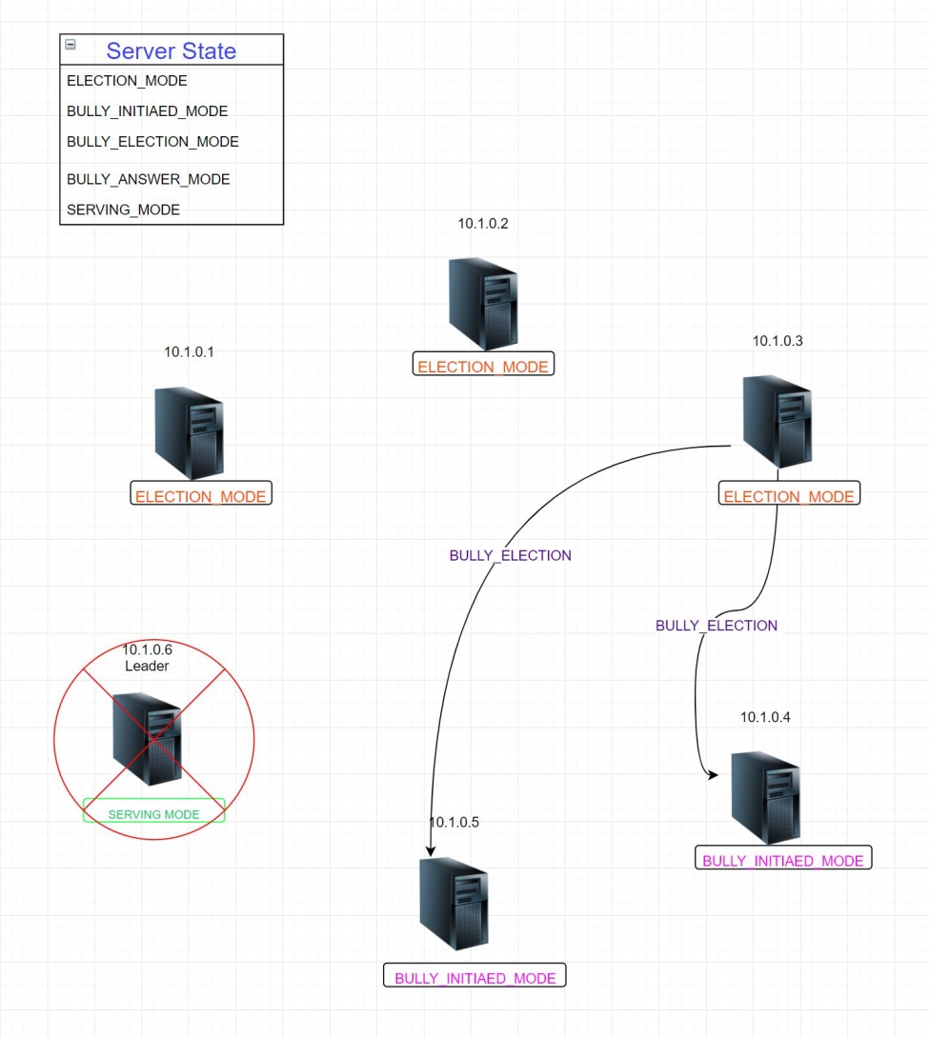

Slide 13
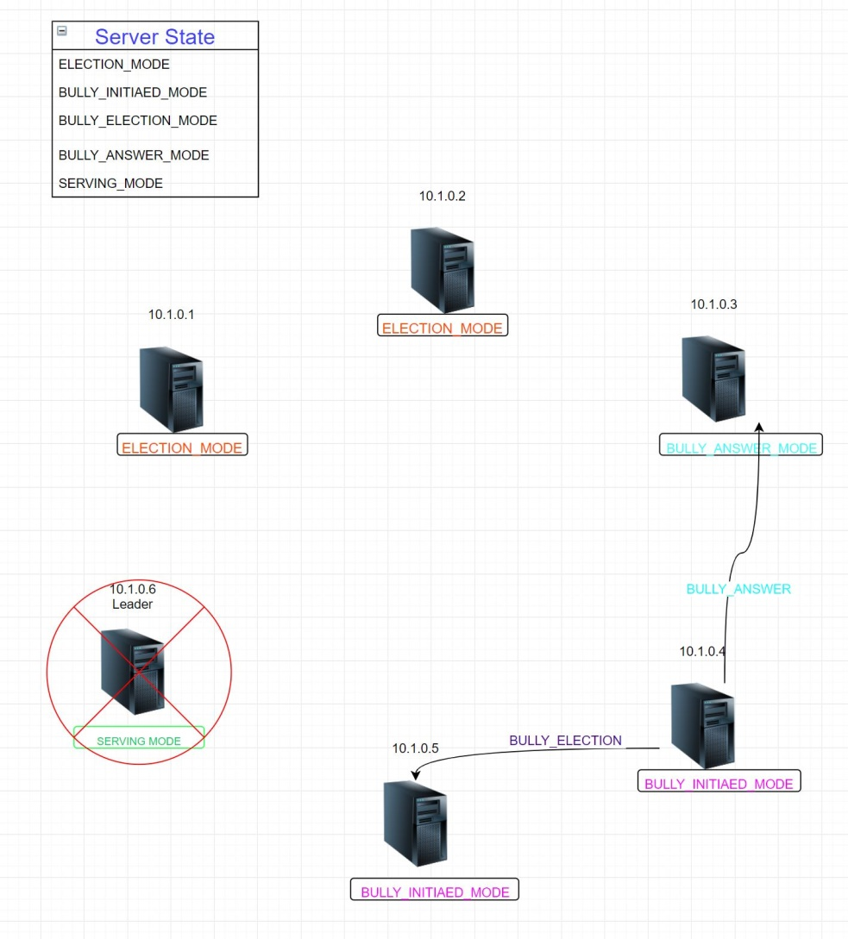

Slide 14
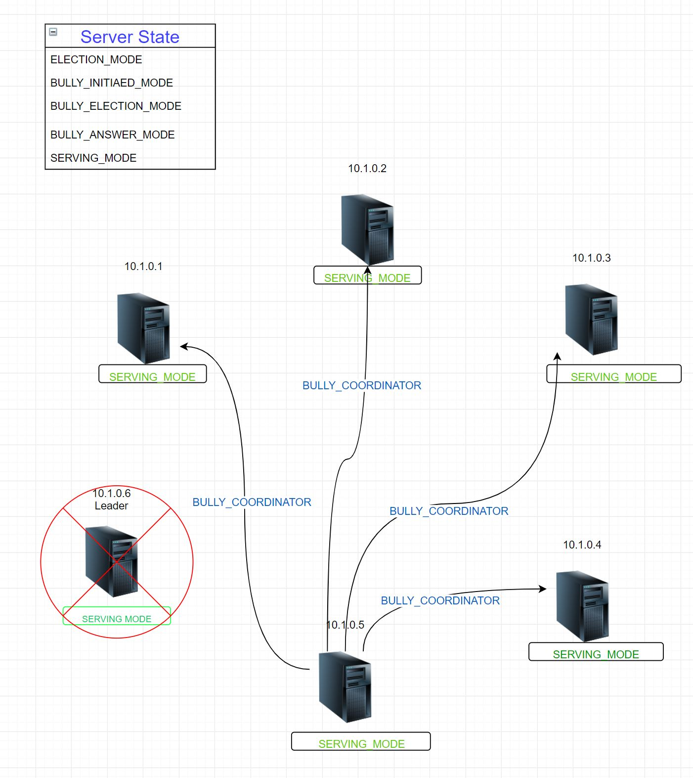

Slide 15
Corner cases
Not Scalable. Leader server handles all (add/modify/delete) requests.
During the concurrent propagation if the leader servers dies there will be some inconsistency with data
If number of server increases then during election some server have overflow of http request queue
If a server is down for some time and re-enter into the system.

Slide 16
Any Questions ?

